Slide 1
RBCCM DIGITAL
What I'm seeing from inside.
An observation, and how it maps to what modern shops are doing.
Notes:
Thanks for the time. I'm here as a contractor, but Marketing has been routing work through me for a while now, so I've had a view most people in my seat don't. What I want to walk you through is a pattern - not a list of complaints - and how it maps to what modern shops are doing.

Slide 2
RBCCM DIGITAL
What the site actually is
HTML pages. A Marketo form.
No login
No client data
No APIs
A marketing site. Nothing more, nothing less.
/ 13
2
Notes:
Before we talk about how it's built - it's worth being explicit about what it is. This is a marketing site. No login. No client data. No transactional layer. The only external touchpoint is the Marketo form. That matters because it should shape what we assume it needs to run.

Slide 3
RBCCM DIGITAL
What it takes to run it today
Current
Ideal
10–15
3–5
people running the site
for a static marketing site of this scope
Underneath: SFTP files by hand. No version control. No CI/CD.
The stack - TeamSite, Bootstrap, dependencies - isn't updated at safe intervals, so every change risks regression. It's fragile.
/ 13
3
Notes:
A modern financial-brand marketing site of this complexity is usually run by 3–5 people. We're at 10–15. You know the actual dollar number - the ratio is what matters: about 3× the team, producing below the market. The workflow underneath is genuinely from 1999. Someone downloads a CSS file, edits it, and SFTPs it back. No version control. No history. No rollback. And nothing in that stack has been kept current for years.

Slide 4
RBCCM DIGITAL
What peers ship
The gap isn't the code - it's the plumbing.
Morgan Stanley
.whatwedo__button
JPMorgan
/etc.clientlibs/ · /content/dam/
RBCCM
.rbccm-leadership__heading
Same discipline. Same BEM. Same component thinking.
/ 13
4
Notes:
Our peers - Morgan Stanley, JPMorgan, most of the bulge bracket - are on Adobe AEM, which is an enterprise CMS in the same category as TeamSite. Their component naming is BEM, same as ours. At the code layer we're at parity. What's different is everything around the code: real build pipelines, content-hashed assets, one-click deploys. We SFTP.

Slide 5
RBCCM DIGITAL
The real problem
It's old tech.
And it's fragile.
A legacy TeamSite build - not even the new visual builder. Every touch risks regression, which is why Marketing has lost trust.
Rebuilding is faster than patching.
/ 13
5
Notes:
This isn't about being on old technology - we're on Bootstrap 5. What's ancient is the maintenance posture. Nothing has been kept current for years. Framework updates get deferred, small fixes accumulate as patches, and every subsequent change collides with the accumulated debt. What used to be a one-line CSS change now takes weeks. That flips the calculus: rebuilding on a modern stack is actually faster than continuing to patch this. That's an unusual claim. It usually means the codebase is past the point where routine maintenance is economically rational.

Slide 6
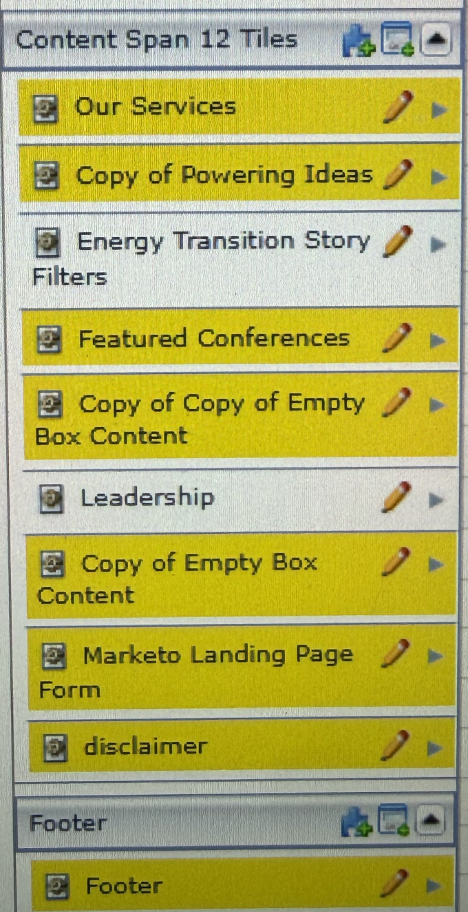
RBCCM DIGITAL
The whole system feels 2005.
This is our authoring UI. It looks and behaves like this everywhere in the system.
When the authoring tooling looks like this, it's not one bad screen. It's the tell for the whole system.
/ 13
6
Notes:
This is what the authoring UI looks like. It's not one bad screen. This is what content editors, marketers, and devs are working through every day, everywhere in the system. When the tooling looks like this, it's the tell for the whole stack - and it's what everyone downstream of it is fighting.

Slide 7
RBCCM DIGITAL
Patterns that hinder forward thinking
1
Architecture accretes.
2
"Security" as a shutdown.
When I got here, three carousel libraries were shipping in production: Owl, Bootstrap, Slick. I was asked to analyze it. I picked Slick because ~80% of instances were already on it.
I put a client-side CMS preview on the site - no server calls, no data leaving the browser, no API surface. It was called a "security risk." There isn't one that I'm aware of.
3
Everything looks back, not forward.
4
Passivity as the safe posture.
Retros focus on what broke. Roadmaps focus on catching up. Nobody's asking what a great product would look like.
When errors get punished and initiative gets shut down, waiting to be told is the rational move. The culture reproduces itself.
/ 13
7
Notes:
Four patterns I've noticed that hinder forward thinking. One: architecture accretes. When I started, three carousel libraries were shipping in production side by side. I was asked to analyze it and pick a direction. I picked Slick because ~80% of instances were already on it. That's what happens without a design system or clear ownership. Two: 'security' as a shutdown. I built a client-side CMS preview to speed up local editing. No server calls, no data leaving the browser. It was called a security risk. There is no security surface on a page that doesn't touch a network - that I'm aware of. Three: everything looks back, not forward. Retros focus on what broke, roadmaps focus on catching up. Nobody's asking what a great product would look like. Four: passivity as the safe posture. When errors get punished visibly and initiative gets shut down, waiting to be told is the rational move. The culture reproduces itself. Not a critique of individuals - a fact about the environment.

Slide 8
RBCCM DIGITAL
…and in the tech itself
5
Override-first authoring.
6
No build pipeline.
New pages, new components, new variations - shipped as overrides on top of existing code rather than composed from a system.
No npm, no Sass/Less compilation. Every override becomes a hardcoded patch, not a reusable pattern.
7
Asset bloat.
8
Feedback loops on every change.
Pages ship JS, CSS, and fonts they don't use. Every page pays the tax of every other page's dependencies.
Remove, replace, check SEO, re-check, sign off. One change becomes 3–4 rounds.
/ 13
8
Notes:
Four more patterns, this time in the tech itself. Five: override-first authoring. Every new page, component, or variation is shipped as an override on top of existing code, not composed from a system. Six: no build pipeline. No npm, no Sass or Less compilation. Every override becomes a hardcoded patch, not a reusable pattern. Seven: asset bloat. Pages ship JS, CSS, and fonts they don't need. Every page pays the tax of every other page's dependencies. Eight: feedback loops on every change. Remove, replace, check SEO, re-check, sign off. One change becomes three or four rounds.

Slide 9
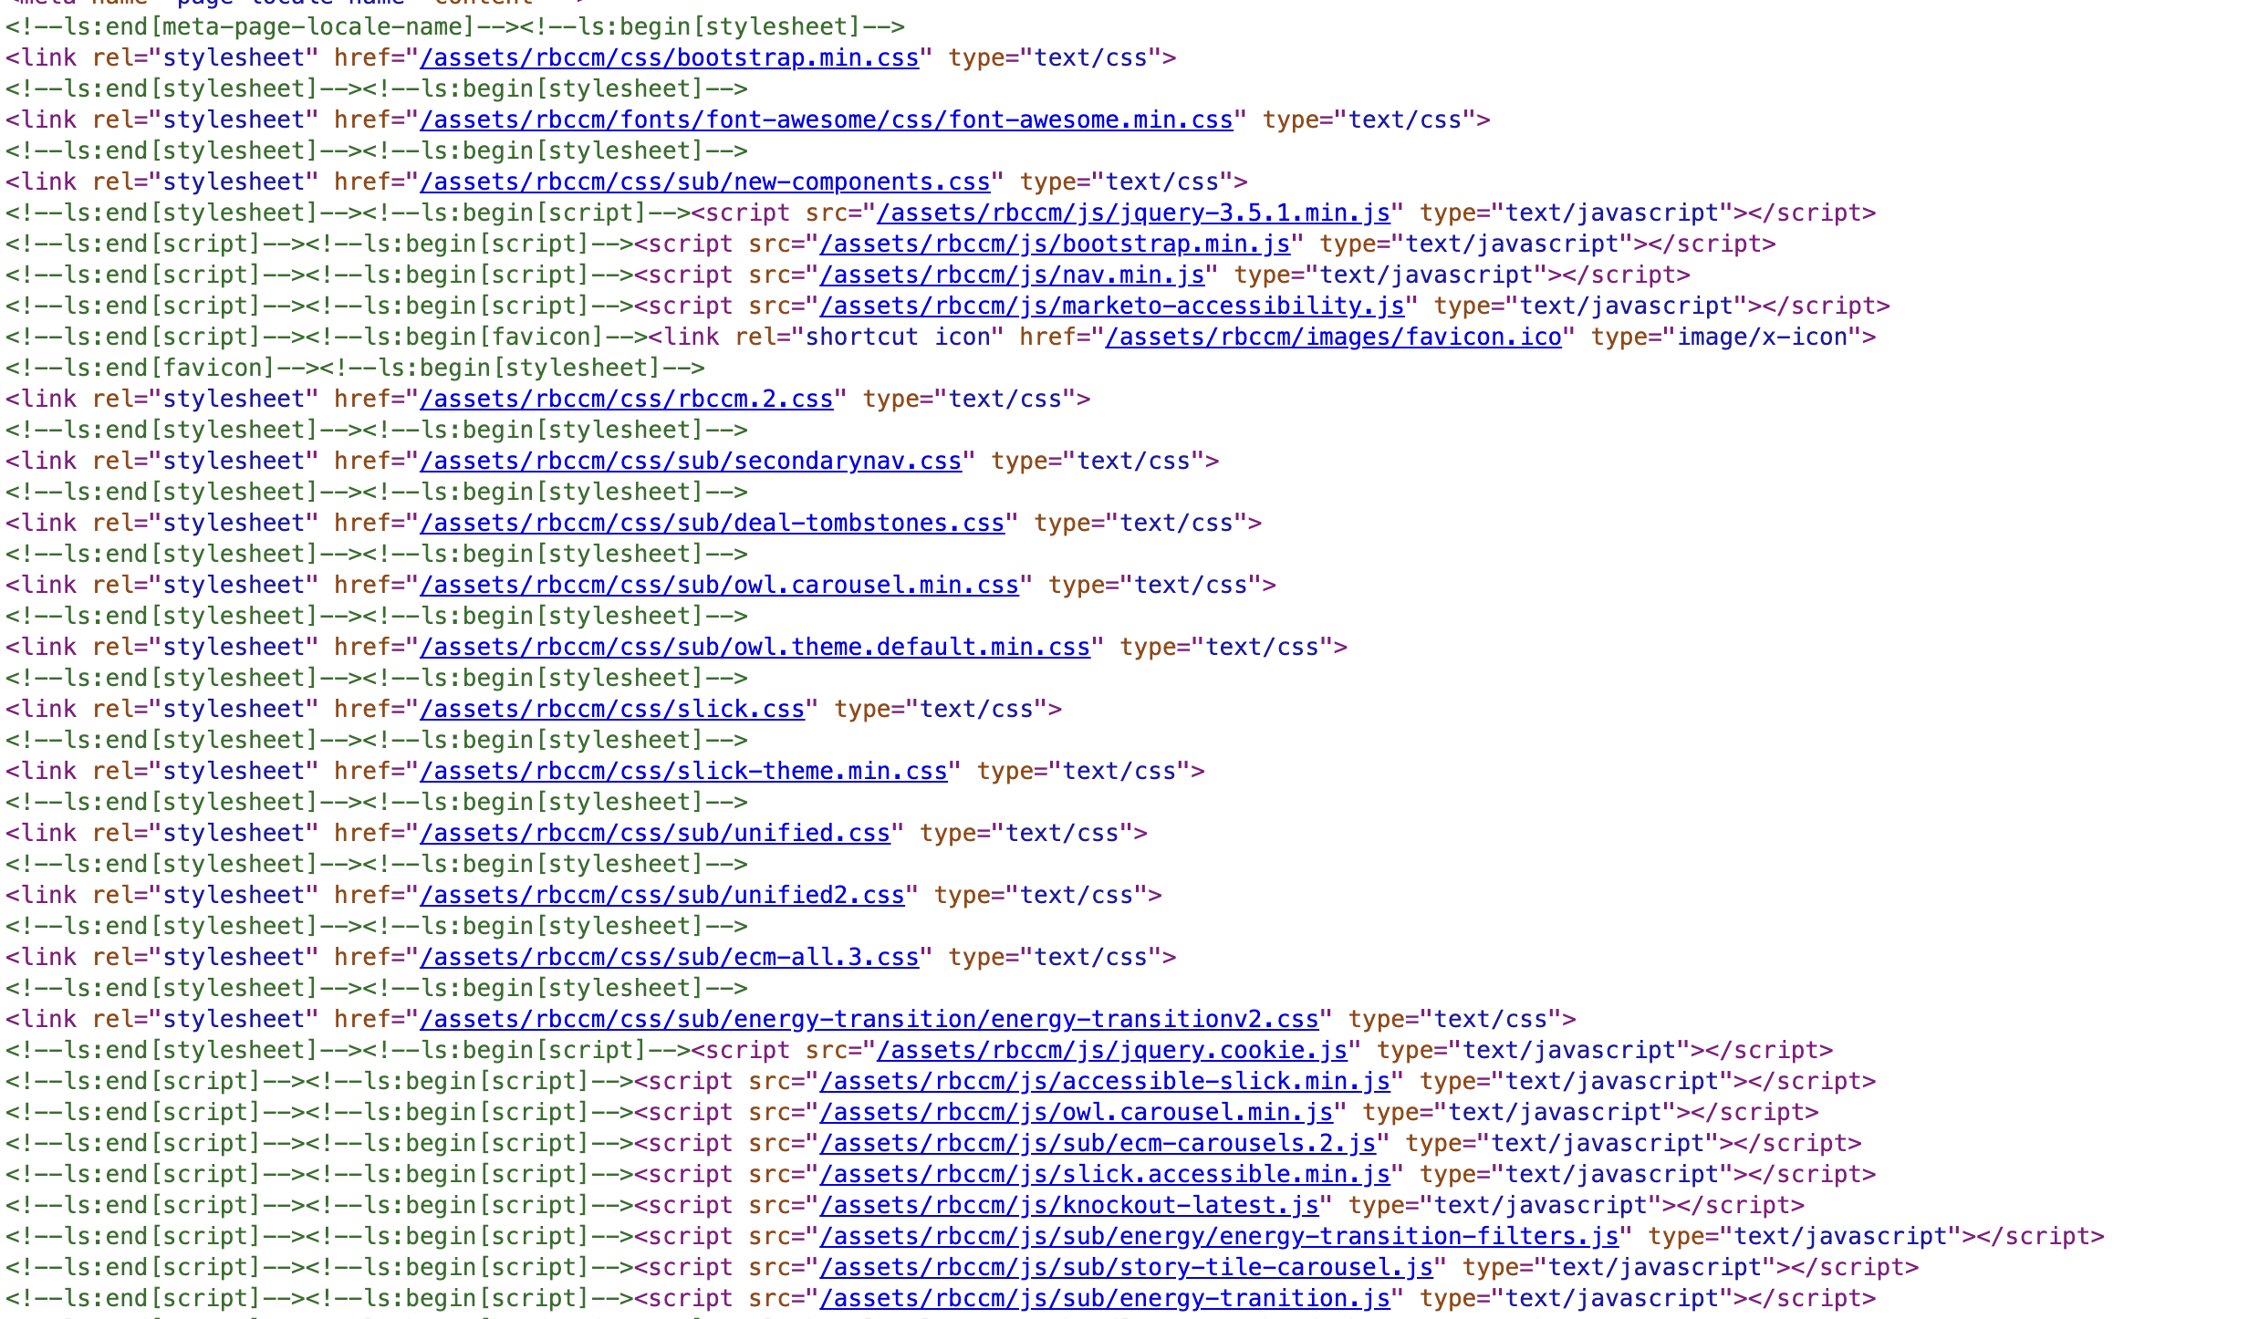
RBCCM DIGITAL
No build. No bundling.
Every component ships its own CSS and JS file, loaded individually in the page head.
SCREENSHOT PLACEHOLDER
page head loading 12+ standalone CSS files
+ 8+ standalone JS files
(paste image here in PowerPoint)
Modern shops ship one main.css and one bundle.js, built through npm. We ship every file individually.
/ 13
9
Notes:
This is our <head>. Every component ships its own CSS and JS file, loaded individually. jQuery, Bootstrap, Slick theme, twelve or more component-specific stylesheets, eight or more component-specific JS files. Notice the 'sub/test/' folder loading in production. There's no npm build. No bundling. No minification pipeline. Modern shops collapse this to one main.css and one bundle.js, built by npm. Every file we add here is another network request, another dependency to keep in sync, another surface for regressions to hide in.

Slide 10
RBCCM DIGITAL
The compounding cost
The patterns compound. That's the cost.
Overrides pile up
→
every change patches more code
No build
→
every patch is manual
Asset bloat
→
every page is slower to build and to load
Feedback loops
→
every change waits on N approvals
Fragility
→
every touch risks regression, which triggers more loops
This is why 10–15 people ship what 3–5 could. The inefficiency isn't a leak - it's a tax on every hour.
/ 13
10
Notes:
None of these patterns individually is fatal. What makes them costly is that they compound. An override piles onto the last one, which slows the next patch, which triggers a feedback loop, which delays the next release. The team spends most of its time patching, checking, and re-checking - not building. That's why the team-size ratio at the start of this deck is what it is. It's not that 10 to 15 people are doing 3 to 5 people's work slowly. It's that the environment forces them to do the same work three times over. The inefficiency isn't a leak somewhere - it's a tax on every hour of every day.

Slide 11
RBCCM DIGITAL
What modern looks like, given what we need
Stays
Goes
Arrives
BEM components
Naming discipline
The work already built on top
The un-maintained CMS layer
SFTP as deploy
Bootstrap as a load-bearing dep
Static-site generator (Next / Astro / Eleventy)
GitHub · PRs · preview on every commit
CI/CD with content-hashed asset builds
One-click rollback
A design system Marketing can pull on directly
Right-sized to the surface we actually have - and stronger on compliance, not weaker.
/ 13
11
Notes:
If we were to modernize, the good news is we'd keep the BEM component work - that transfers. What changes is the plumbing: a static-site generator, GitHub with previews on every PR, CI/CD, one-click rollback, and a design system Marketing can pull on directly. Right-sized to what this actually is - a marketing site. And this improves our compliance posture, not the reverse. Automated dependency updates keep vulnerability scans clean. CI-integrated a11y testing catches regressions before deploy. Consent management is a plug-in, not a rebuild.

Slide 12
RBCCM DIGITAL
About the CMS evaluation
Six platforms are on the table. All headless.
Storyblok
DotCMS
WordPress
AEM
Contentful
Contentstack
Gold = shipped production sites on this platform
From what I've seen, no one on the team has shipped a headless site.
Same operating-model gap: evaluating what to buy without evaluating who can operate it.
I've shipped WordPress (headless and classic), AEM, Contentful, and DotCMS. I've led teams at tech-lead and director level in past roles. I know how to lead this.
/ 13
12
Notes:
One more piece of context. The team is currently evaluating six platforms, all headless: Storyblok, DotCMS, WordPress, AEM, Contentful, Contentstack. From what I've seen, no one on the team has actually shipped a headless site before. That's my read, not a formal audit, but it's the pattern I keep running into. Same operating-model gap as everywhere else: we're evaluating what to buy without evaluating who can operate it. For context on my end: I've shipped production sites on WordPress in both headless and classic modes, on AEM, on Contentful, and on DotCMS. I've built on modern frameworks and modern CMSs, and I've led teams at the tech-lead and director level in past roles. Whichever way this goes, I know how to lead this.

Slide 13
RBCCM DIGITAL
Aim forward, not backward.
We can build something better.
Happy to lead this. We just need to decide to.
/ 13
13
Notes:
That's what I'm seeing, and where I think we should go. Focus forward, not on patching what's behind us. We can build something better than what we have. Happy to lead it. We just need to make the decision to.

